Slide 1

Vehicle Insurance Data Warehouse
TANMAY ATKEKAR

Slide 2

Company Description
The insurance company XYZ provides various insurances to different Automobiles across USA.
The company has different covers for each vehicle depending on Driver’s driving history, points on license, vehicle details and type etc.

Slide 3
Data Warehouse mission statement
The objective behind building a data warehouse is connecting data from source systems, applying transformations and storing into one repository for better data flow across the organization.
This finally helps in better analytics considering vast data coming from different sources, which results in data-based decision making across the organization.
The data warehouse repository will also be used across different departments to serve their data and reporting needs

Slide 4
Business case
The need of central data warehouse repository is imminent because data is spread across various sources, causing inconsistent data flow throughout the organization.
This results in poor analytical operations being performed across organization, ultimately resulting in slow growth of organization.

Slide 5
Project Scope
The scope consists of four major activities:
Creating data warehouse
Breaking the DW down into data marts
Creating BI plan
Maintenance of DW

Slide 6

Project Stakeholders
Project Sponsor: Director of XYZ company who is funding the project
Project Team: Team responsible for implementing the data warehouse
End Users: Employees using the DW for data and analytical purposes
Review board: The team responsible to check whether the DW meets the requirements

Slide 7

Interview Questions
What are the data sources and type of data?
What regulations do we need to adhere to?
What kind of reporting and analytical services it should provide?
Do we need Data marts or just one consolidated DW?
What are the existing data security measures?
Do you need the team to support the data warehouse or it can be done in house?
What are current problems while extracting data from different sources for analytical purposes?

Slide 8
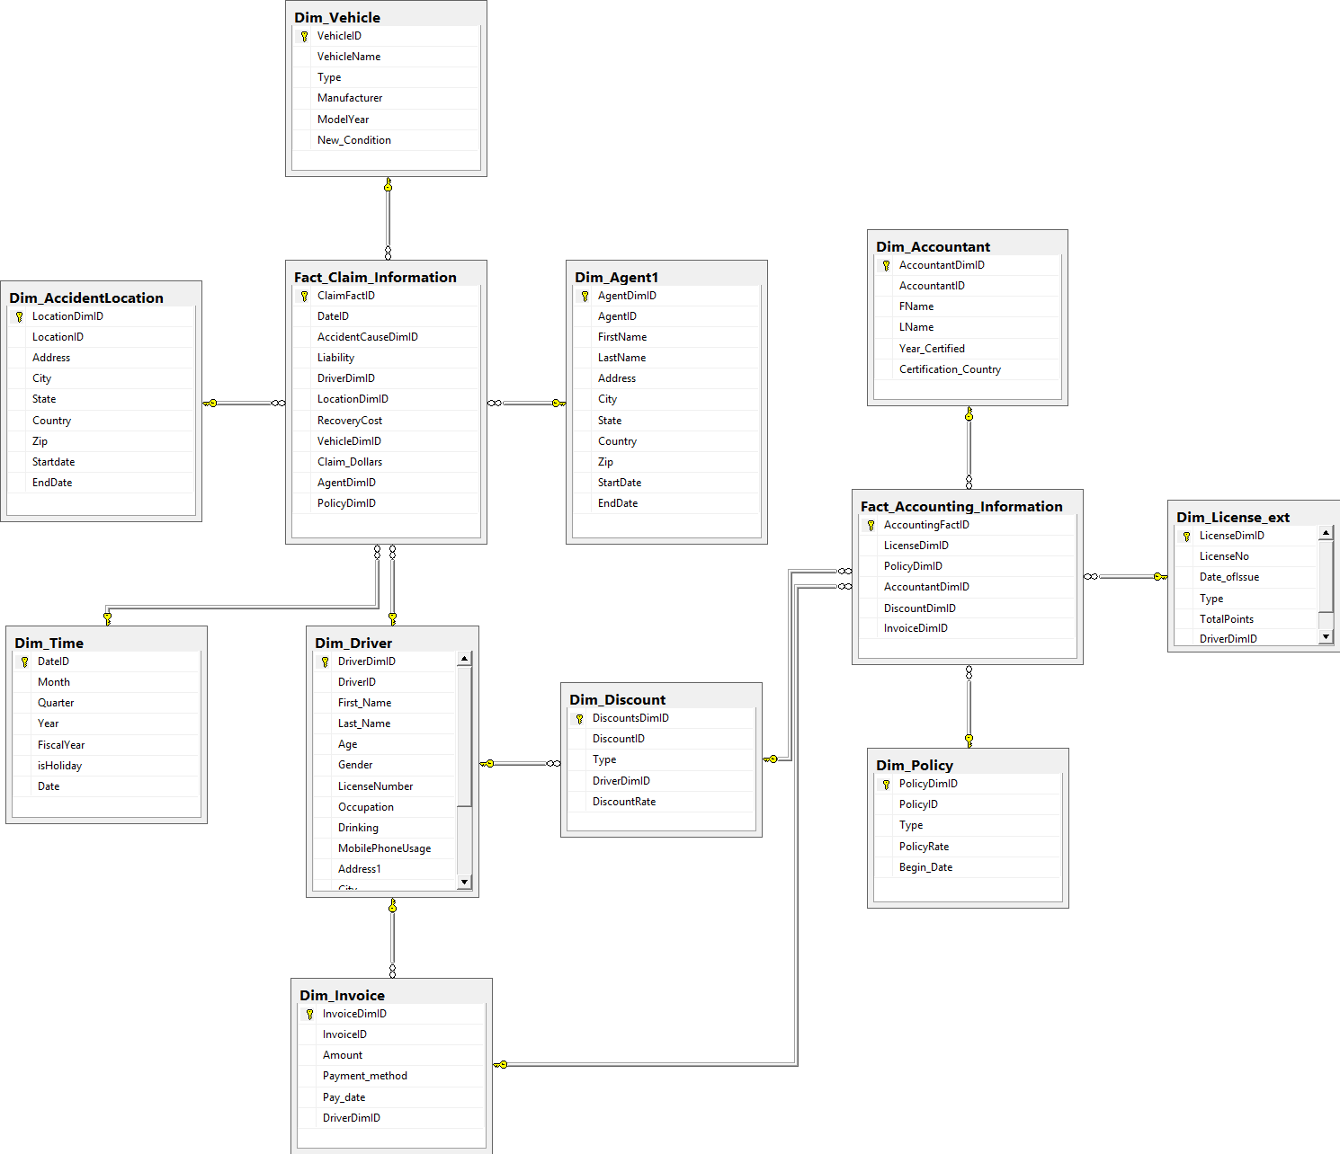
Data Warehouse Schema Design

Slide 9
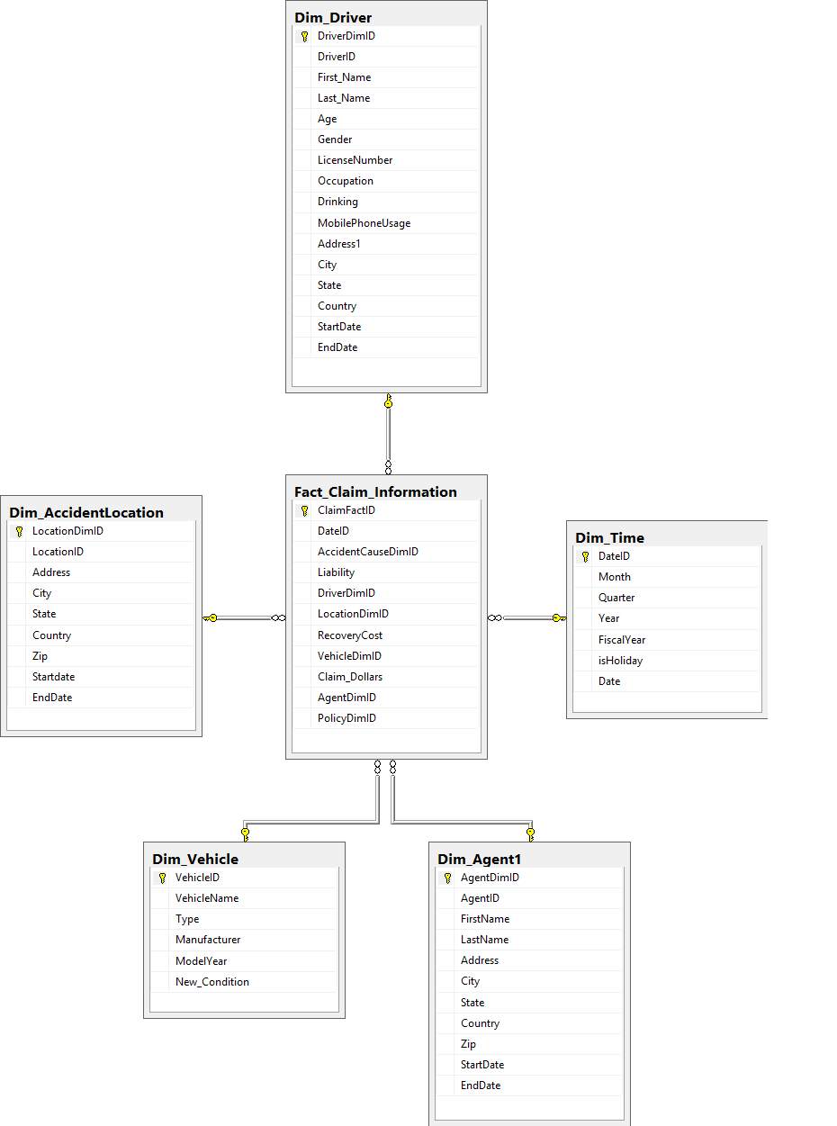
Data Marts Schema Design 1. Claim Information DM

Slide 10
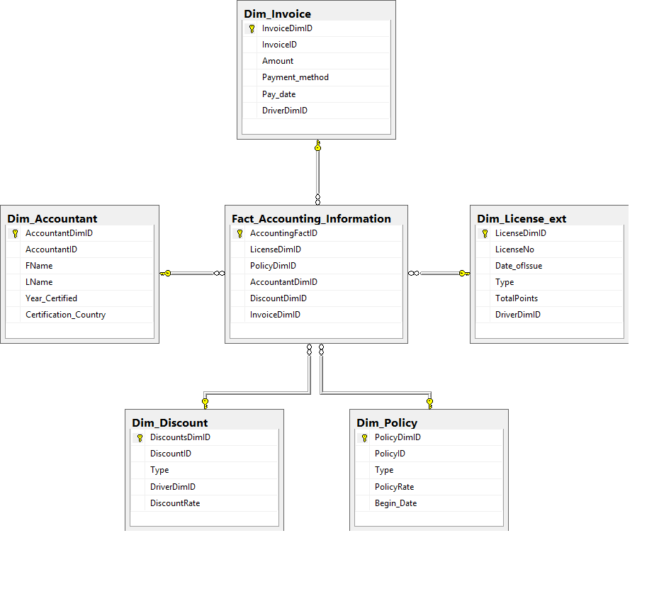
Data Marts Schema Design 2. Accounting DM

Slide 11
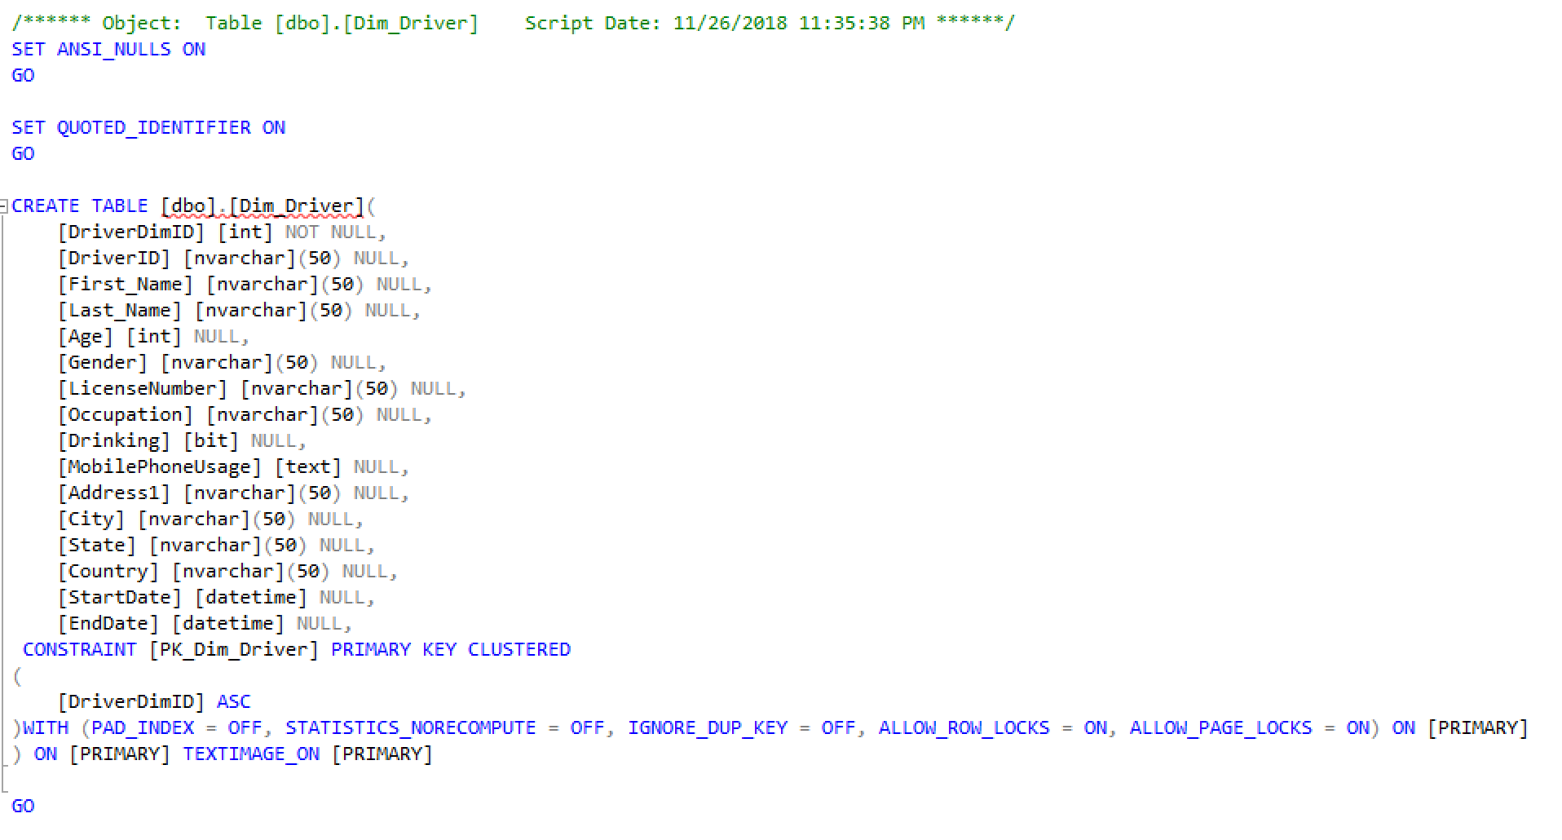
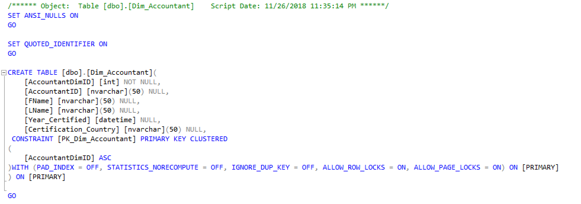
SQL-Build (create)Dim_Tables

Slide 12
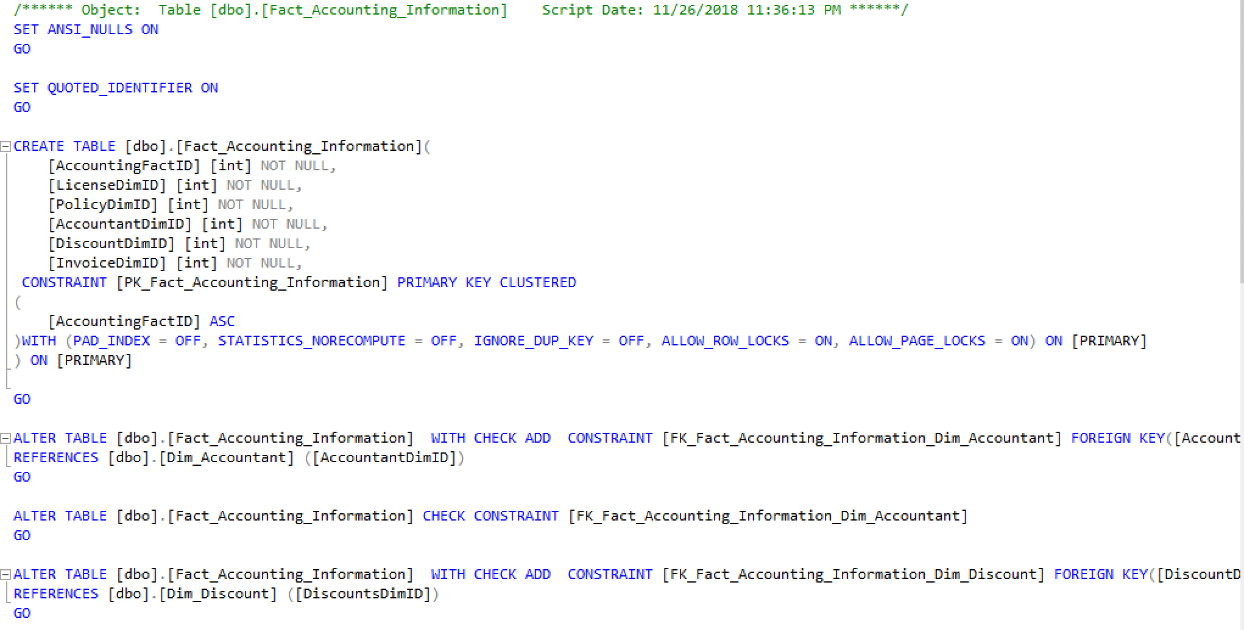
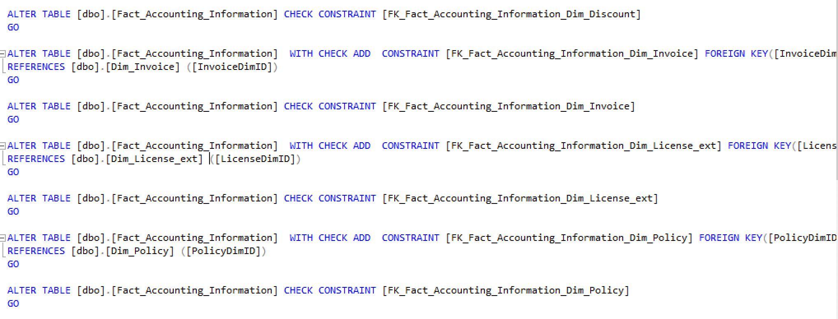
SQL-Build (create) Fact_Accounting

Slide 13
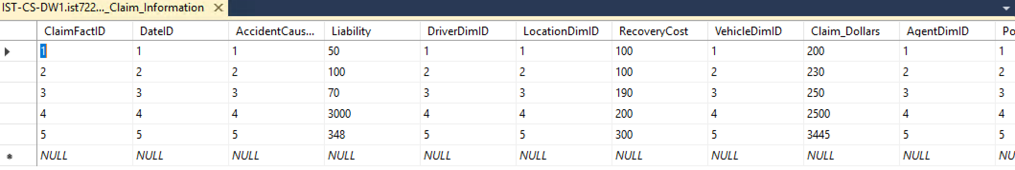
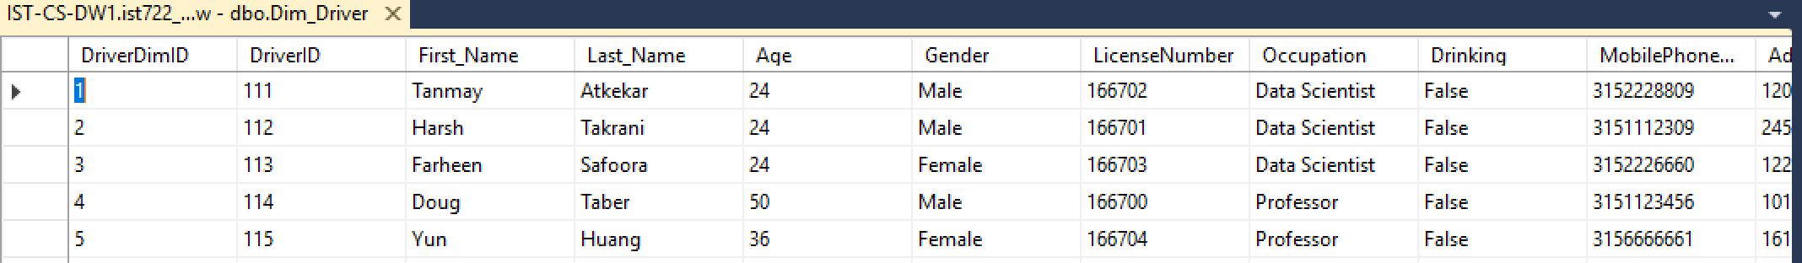
SQL-Build (insert)

Slide 14
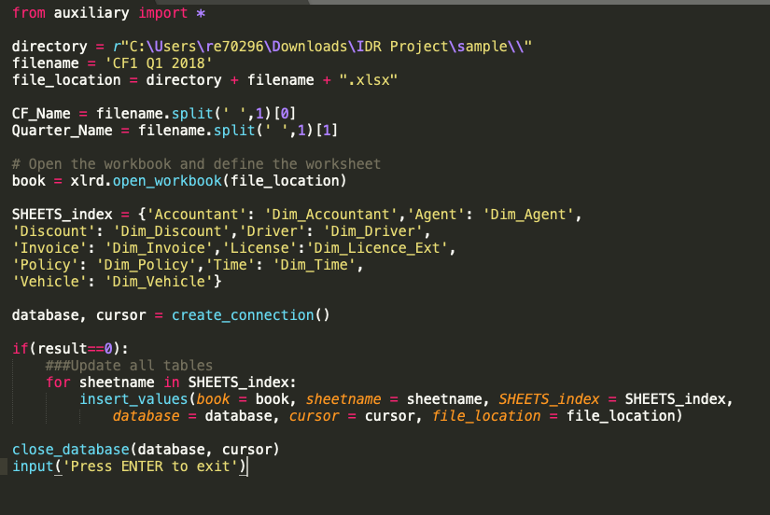
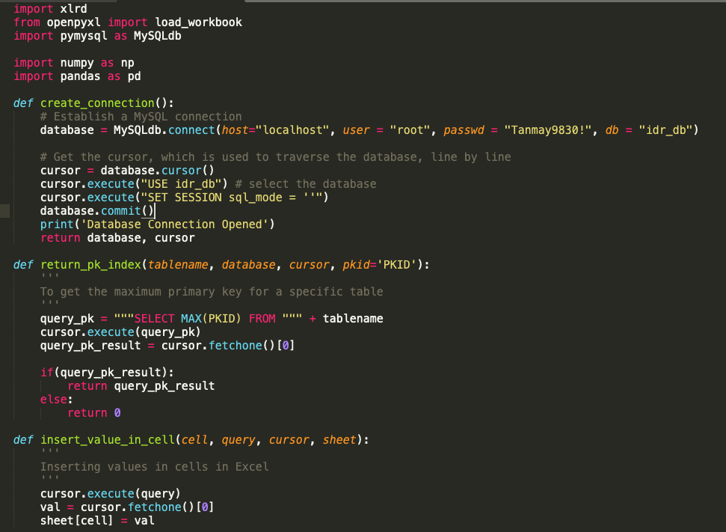
ETL Script using Python

Slide 15
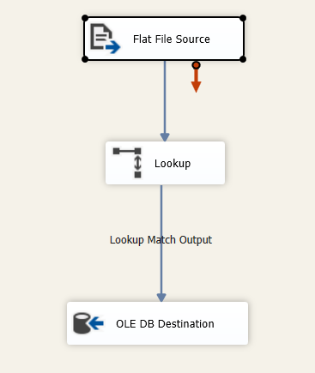
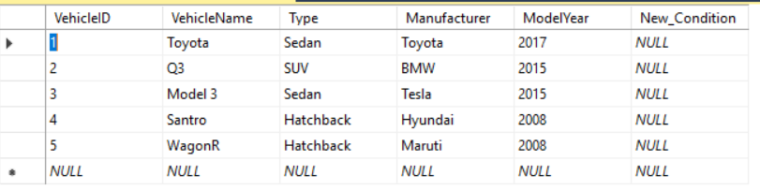
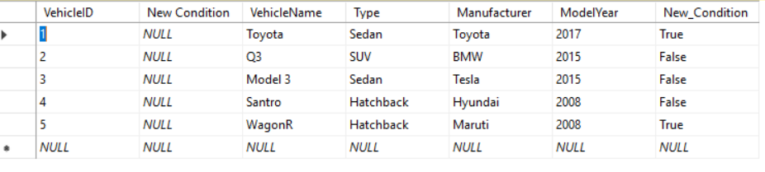
Lookup Transformation in SSIS

Slide 16
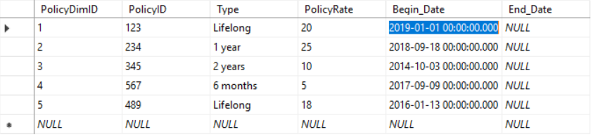
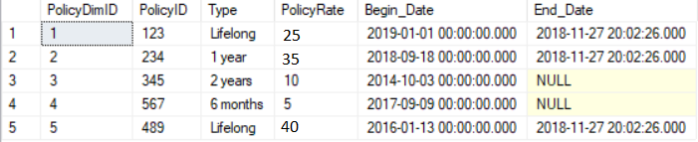
ETL Implementation SCD-2
Before change in Policy Rate
After change in Policy Rate

Slide 17
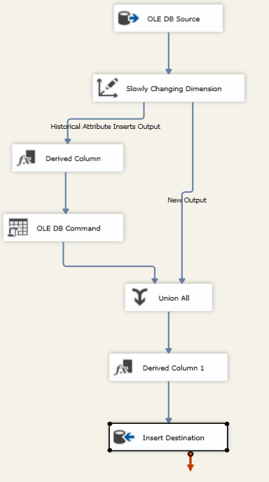
SCD-2 Dataflow in SSIS

Slide 18
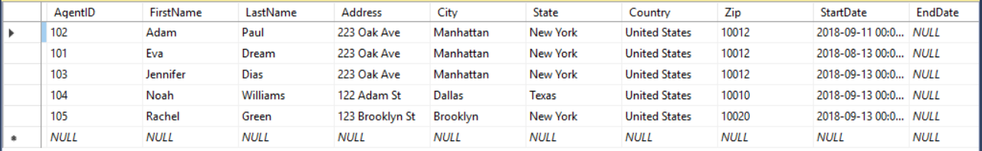
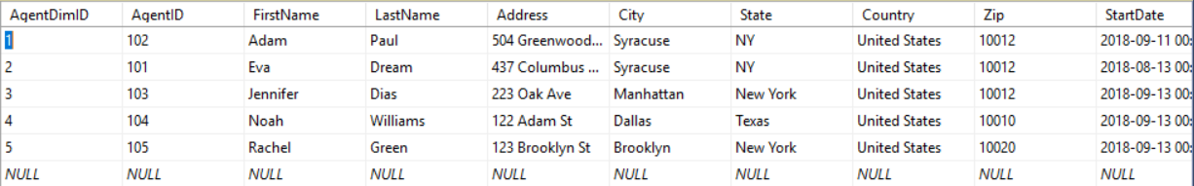
ETL Implementation – SCD 3
Before change in Address
After change in Address

Slide 19
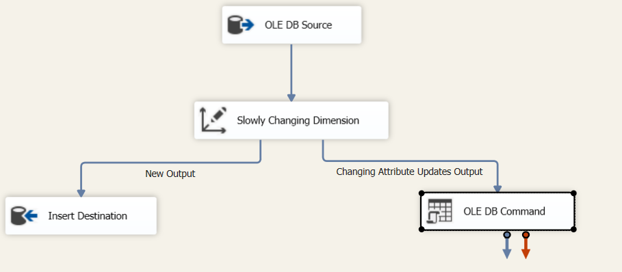
SCD 3 Data Flow

Slide 20
Maintenance Plan
Assign
Assign data loading times into the data warehouse
Purge
Purge data: get rid of unwanted data in the data warehouse as it is not an unlimited repository
Tune
Tune the system: Periodically review how the data warehouse is being used and fine tune the configuration to optimize its performance

Slide 21

Conclusion
This newly formed central repository i.e. data warehouse is summarized data coming from various sources, without loss of any valuable information which is used for better decision making across the organization.

Slide 22
Thank You

